Slide 1

MDA 720
Capstone Project
Strategic Insights for Airbnb Hosts: Enhancing Property Listings through Data-Driven Ecommerce Solutions
By Taghi Jalilov

Slide 2

Introduction
This report introduces a pioneering business idea—launching an e-commerce platform specifically designed for Airbnb hosts. The platform will offer a range of products and services meticulously chosen to enhance the attractiveness and functionality of Airbnb properties. From sophisticated interior décor to cutting-edge smart home devices, our offerings will empower hosts to elevate their guests' experience and, consequently, their own success metrics.

Slide 3

Data Extraction
The dataset has been taken from data.world : https://data.world/ajsanne/sf-airbnb-listings
This Dataset includes the listings and reviews of Apartments/ homes located in Amsterdam.

Slide 4
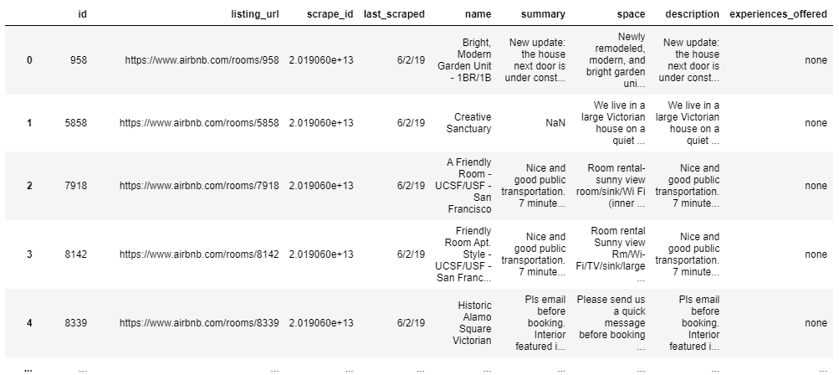
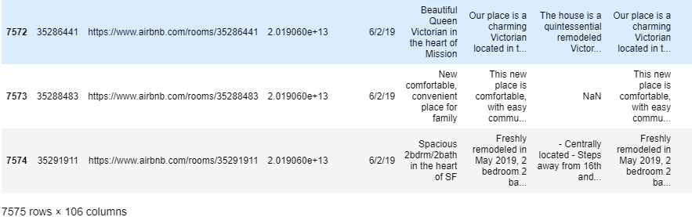
7000 rows and 106 columns.

Slide 5
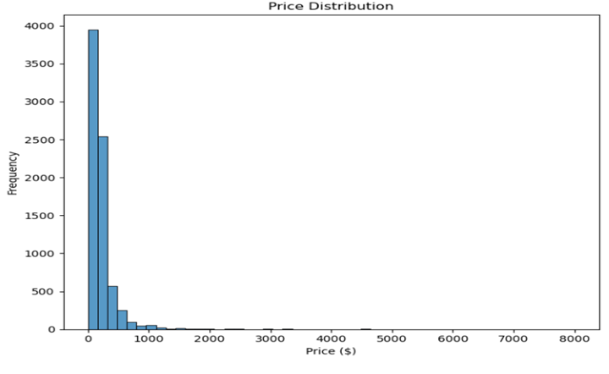
Price Distribution:
The histogram illustrates the frequency of different prices among Airbnb listings. The x-axis represents the price in dollars, and the y-axis represents the frequency of listings at each price point.

Slide 6
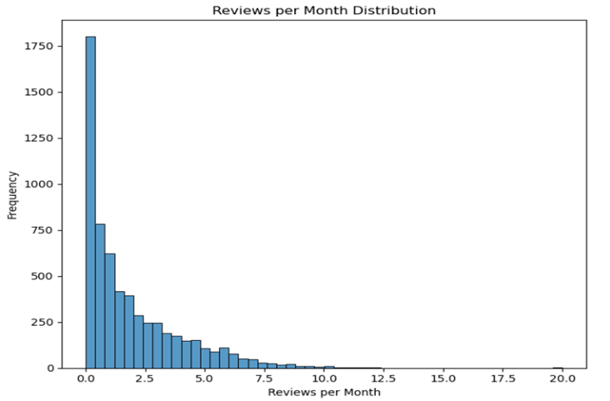
Reviews Per Month Distribution:
The histogram shows how reviews per month are distributed among Airbnb listings. The x-axis shows the number of reviews per month, and the y-axis shows how frequently each review count occurs.

Slide 7
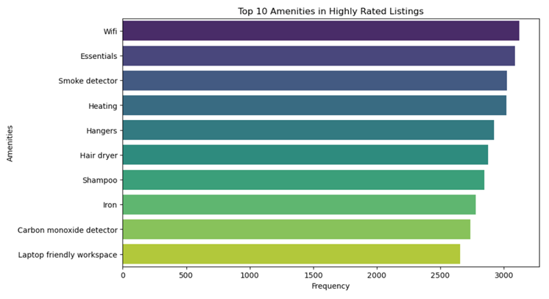
WiFi appears to be the most common amenity, followed by Essentials (like towels, bed sheets, soap, and toilet paper).
Smoke detectors and Heating are also highly prevalent.
Other amenities in the top 10 include Hangers, Hair dryer, Shampoo, Iron, Carbon monoxide detector, and Laptop-friendly workspace.

Slide 8
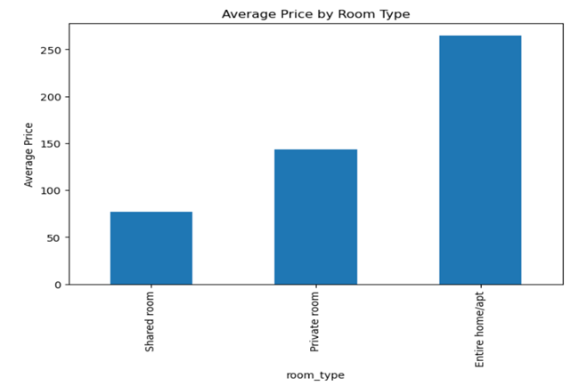
Price Analysis by Room Type:
Insights:·
Privacy Premium: The clear price stratification by room type suggests a direct correlation between the level of privacy and the pricing. Guests pay more for enhanced privacy and exclusive amenities.
Market Positioning: Hosts can adjust their offerings based on these insights—for instance, upgrading room features or reconfiguring spaces could justify higher pricing within each category.

Slide 9
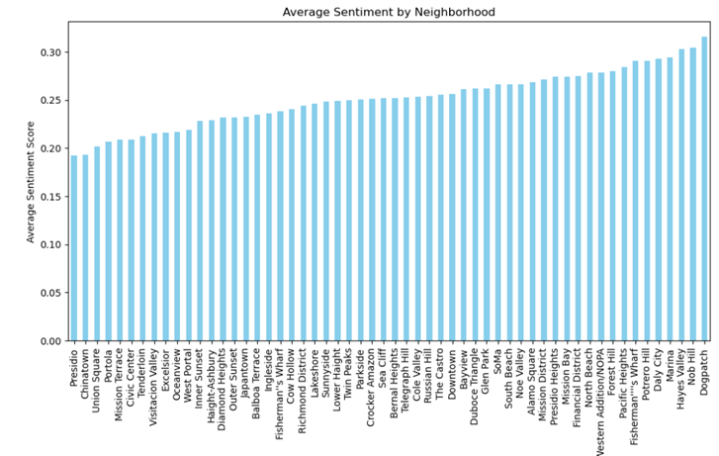
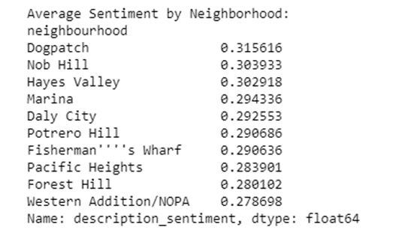
Sentiment Analysis

Slide 10
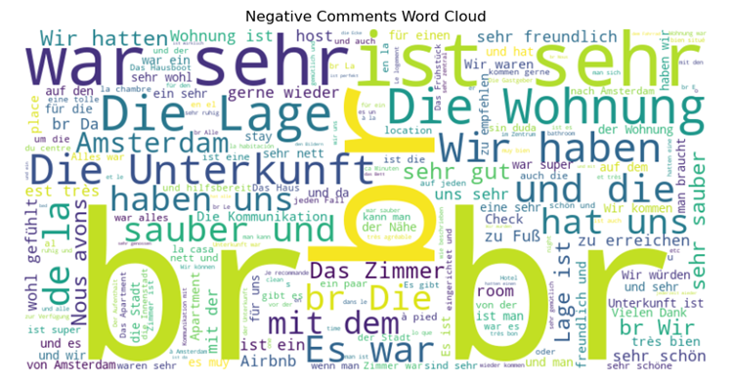
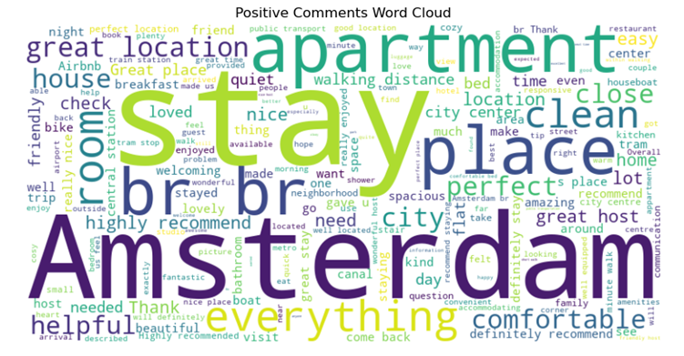
Positive and Negative Sentiments

Slide 11
Conclusion
The analysis conducted across various Airbnb data visualizations and sentiment metrics provides valuable insights into pricing strategies, neighborhood popularity, review frequencies, and the emotional appeal of property descriptions. Here's a consolidated conclusion based on the findings:
Lower-priced listings tend to attract more reviews, suggesting higher occupancy rates. This indicates that pricing strategies should be keenly managed to balance profitability with competitive pricing to maximize booking potential.
Entire homes/apartments command higher prices and therefore require distinct value propositions to justify higher costs to potential guests.

